Slide 1
INTRODUCTION TO PHP
BY This TWO:

Slide 2
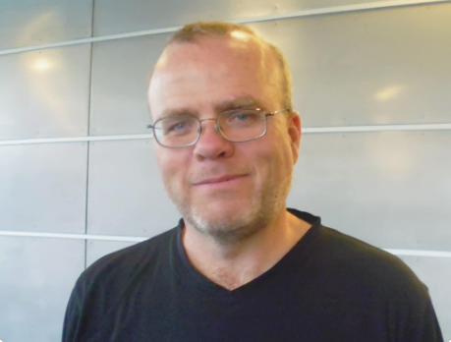
What is PHP?
PHP, or 'Hypertext Preprocessor,'
is a server-side scripting language
mainly used for web development.
Created in 1994 by Rasmus Lerdorf,
it started as 'Personal Home Page Tools,' a simple set of scripts to track visitors to his website. Over time, it evolved into a widely used language, now maintained by The PHP Group and an active community of developers.

Slide 3
How PHP Works?
PHP code runs on the server, not in the browser, which makes it secure and allows it to create dynamic pages quickly. The server processes the PHP code and sends the resulting HTML to the user's browser.

Slide 4
Key Features of PHP
Open Source: Free to use, with extensive resources available.
Cross-Platform: Runs on multiple operating systems (Windows, Linux, macOS).
HTML Integration: Can be easily embedded in HTML.

Slide 5

What Can PHP Do?
Dynamic Content: PHP generates pages that change based on user input.
File Handling: PHP can create, read, and delete files on the server.
Form Data Processing: PHP gathers and processes data from forms.
Database Interaction: Connects to databases like MySQL.
Data Encryption: Can securely encrypt sensitive data.

Slide 6

PHP powers many websites, especially platforms like WordPress, Facebook, and Wikipedia making PHP skills valuable in web development. Its ease of use and versatility make it popular among developers.

Slide 7
Basic PHP Syntax Examples:
Hello World Example
<?php
echo "Hello, World!";
?>
Variables in PHP
<?php
$name = "John“:
echo "Hello, " . $name;
?>

Slide 8
Simple Arithmetic
<?php
$x = 5;
$y = 10;
$sum = $x + $y;
echo "The sum is: " . $sum;
?>
Conditional Statements
<?php
$age = 20;
if ($age >= 18) {
echo "You are eligible to vote.“;
} else {
echo "You are not eligible to vote.";
}
?>

Slide 9
Loops in PHP
<?php
for ($i = 1; $i <= 5; $i++) {
echo "Number: " . $i . "<br>";
}
?>
Functions in PHP
<?php
function greet($name) { return "Hello, " . $name;
}
echo greet("Alice“);
?>

Slide 10
Working with Arrays
<?php
$fruits = array("Apple", "Banana", "Cherry"); echo "I like " . $fruits[0];
?>

Slide 11
FIN

